Slide 1
CS 179: GPU Programming
Lecture 8

Slide 2
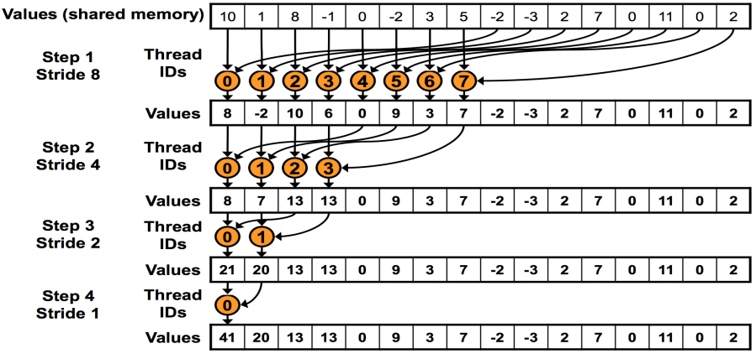
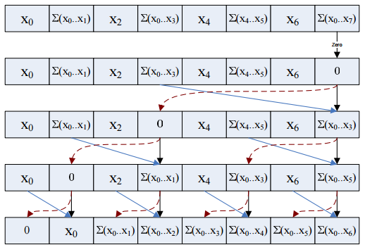
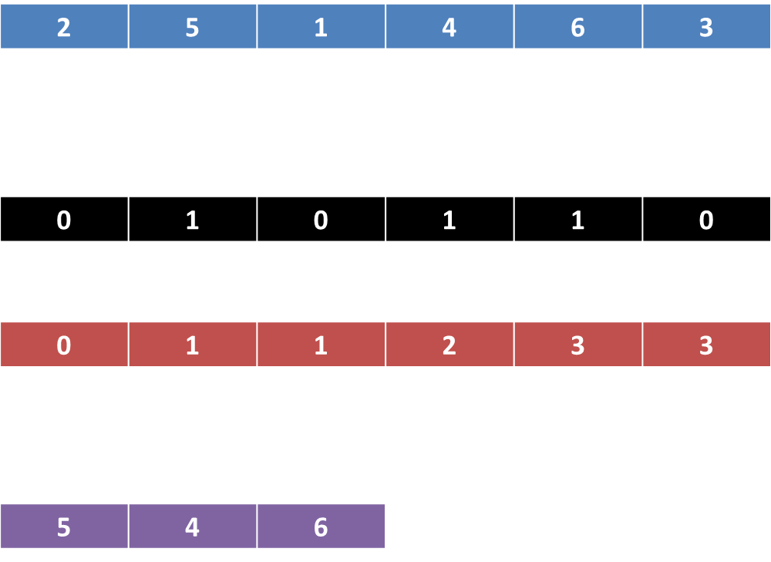
Last time
GPU-accelerated:
Reduction
Prefix sum
Stream compaction
Sorting (quicksort)

Slide 3
Today
GPU-accelerated Fast Fourier Transform
cuFFT (FFT library)
Don’t worry about the math and even algorithmic details TOO much. This lecture should be a case study in why you shouldn’t re-invent the wheel (implement what a library already does for you)

Slide 4
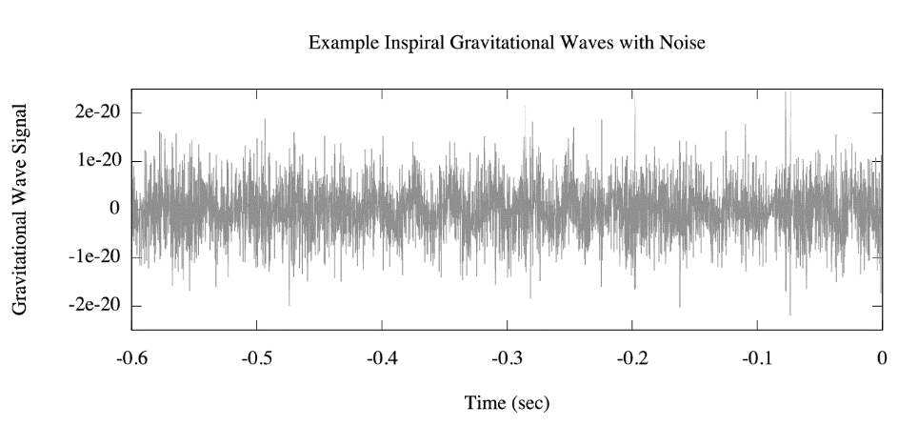
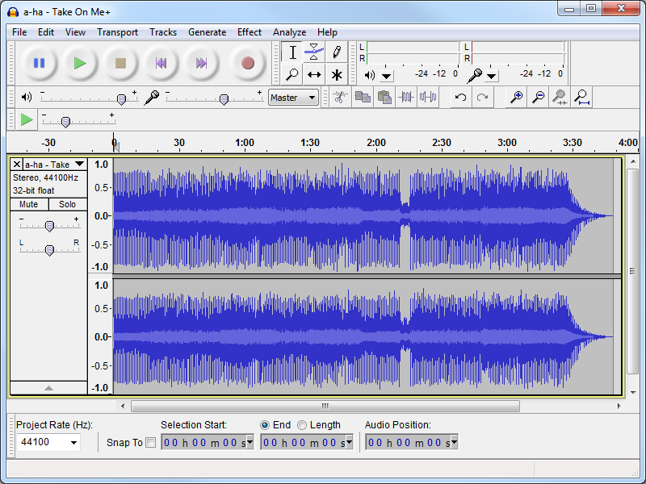
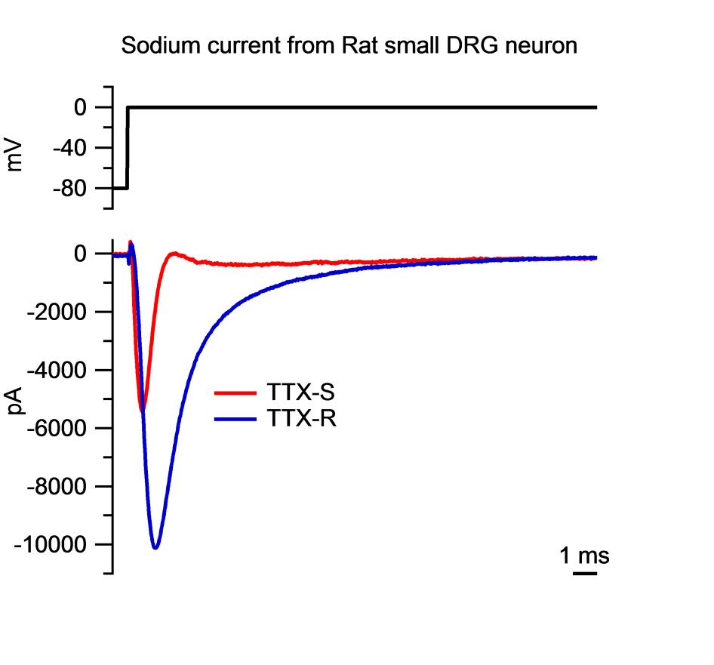
Signals (again)

Slide 5
“Frequency content”
What frequencies are present in our signals?

Slide 6
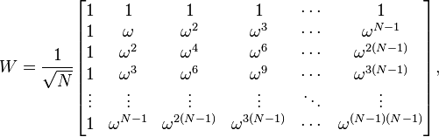


Discrete Fourier Transform (DFT)
Given signal $\vec{x}=(x_{1},…,x_{N})$ over time,
$\vec{y}=W\vec{x}$ represents DFT of $\vec{x}$
Each row of W is a complex sine wave
Each row multiplied with $\vec{x}$ - inner product of wave with signal
Corresponding entries of $\vec{y}$ - “content” of that sine wave!
$ω=e^{−2πi/N}$

Slide 7
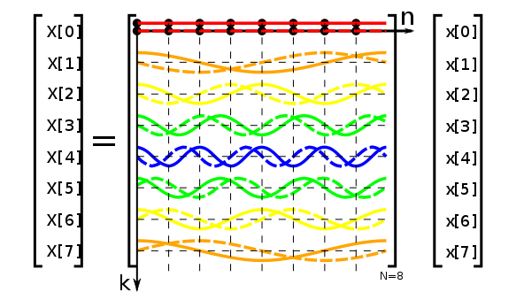
Solid line = real part
Dashed line = imaginary part

Slide 8


Discrete Fourier Transform (DFT)
Alternative formulation:
$X_{k}$ - values corresponding to wave k
Periodic – calculate for 0 ≤ k ≤ N - 1

Slide 9
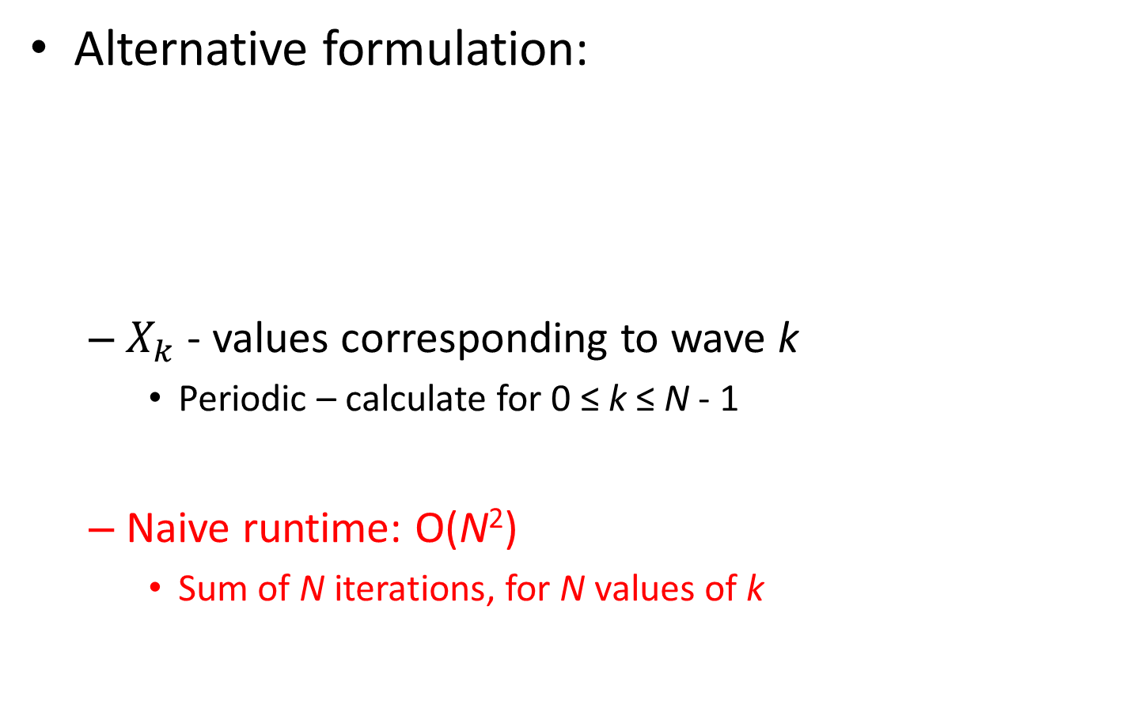
Discrete Fourier Transform (DFT)
Alternative formulation:
$X_{k}$ - values corresponding to wave k
Periodic – calculate for 0 ≤ k ≤ N - 1
Naive runtime: O(N²)
Sum of N iterations, for N values of k

Slide 10
Discrete Fourier Transform (DFT)
Alternative formulation:
$X_{k}$ - values corresponding to wave k
Periodic – calculate for 0 ≤ k ≤ N - 1
Naive runtime: O(N²)
Sum of N iterations, for N values of k

Slide 11
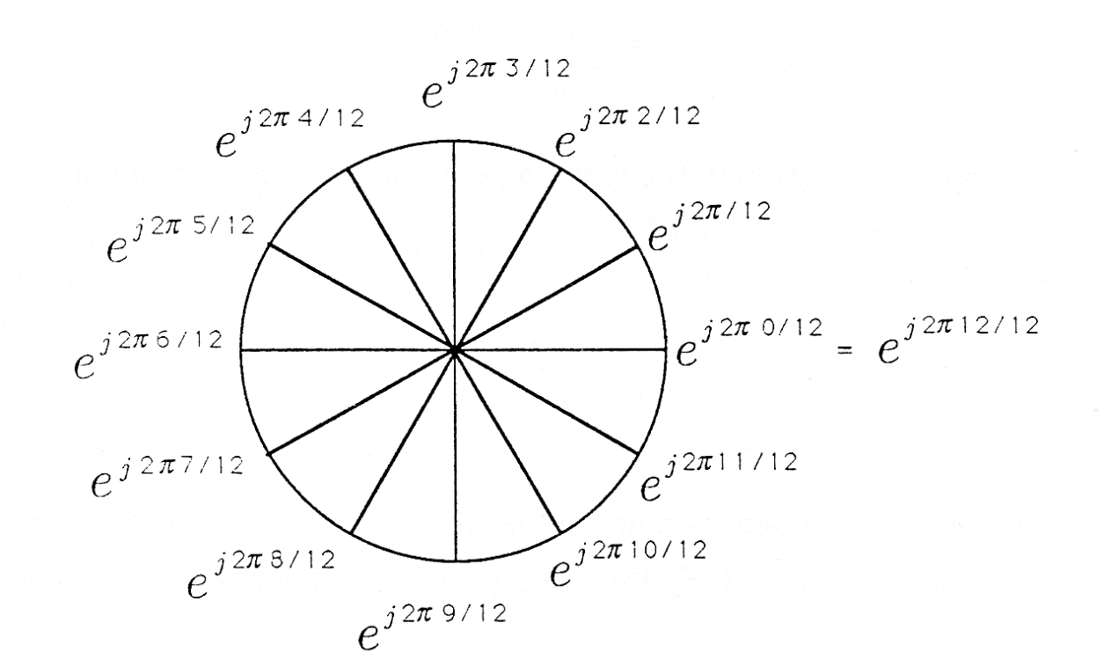
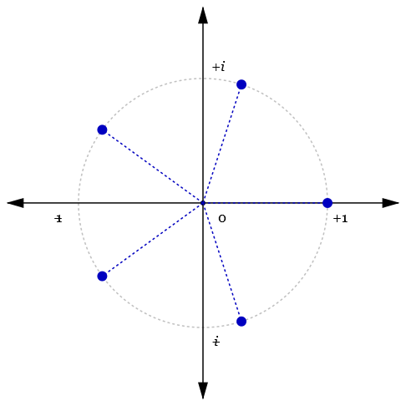
Roots of unity

Slide 12

Discrete Fourier Transform (DFT)
Alternative formulation:
$X_{k}$ - values corresponding to wave k
Periodic – calculate for 0 ≤ k ≤ N - 1
Number of distinct values: N, not N²!

Slide 13

(Proof)
Breakdown (assuming N is power of 2):
(Let $ω_{N}=e^{−2πi/N}$, smallest root of unity)
$$\sum_{n=0}^{N−1}{x_{n}{ω_{N}}^{kn}}$$

Slide 14

(Proof)
Breakdown (assuming N is power of 2):
(Let $ω_{N}=e^{−2πi/N}$, smallest root of unity)
$$\sum_{n=0}^{N−1}{x_{n}{ω_{N}}^{kn}}$$
$$=\sum_{n=0}^{N/2−1}{x_{(2n)}{ω_{N}}^{k(2n)}}+\sum_{n=0}^{N/2−1}{x_{(2n+1)}{ω_{N}}^{k(2n+1)}}$$

Slide 15
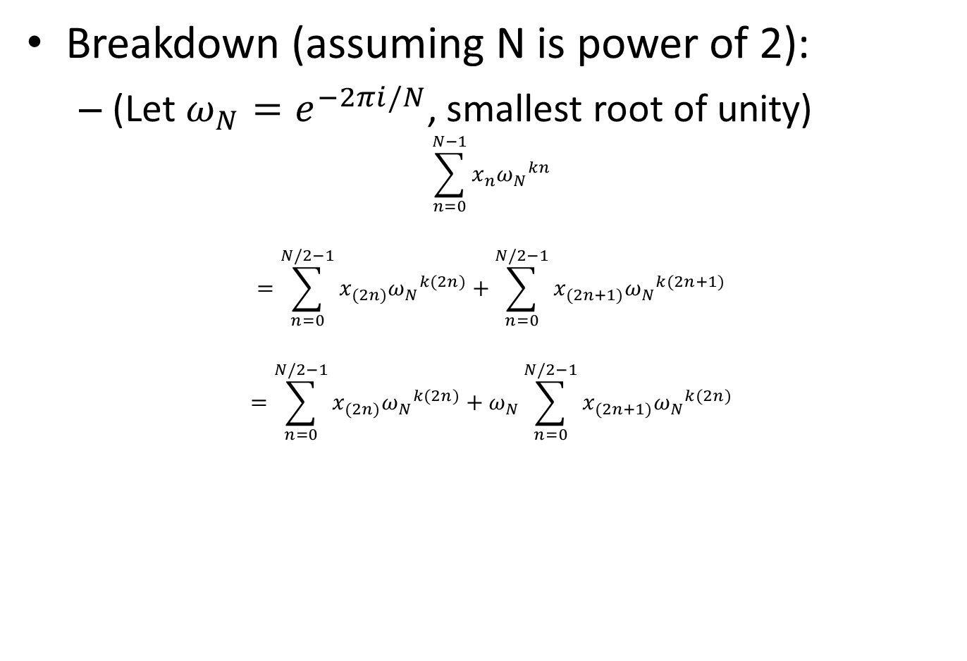
(Proof)
Breakdown (assuming N is power of 2):
(Let $ω_{N}=e^{−2πi/N}$, smallest root of unity)
$$\sum_{n=0}^{N−1}{x_{n}{ω_{N}}^{kn}}$$
$$=\sum_{n=0}^{N/2−1}{x_{(2n)}{ω_{N}}^{k(2n)}}+\sum_{n=0}^{N/2−1}{x_{(2n+1)}{ω_{N}}^{k(2n+1)}}$$
$$=\sum_{n=0}^{N/2−1}{x_{(2n)}{ω_{N}}^{k(2n)}}+ω_{N}\sum_{n=0}^{N/2−1}{x_{(2n+1)}{ω_{N}}^{k(2n)}}$$

Slide 16
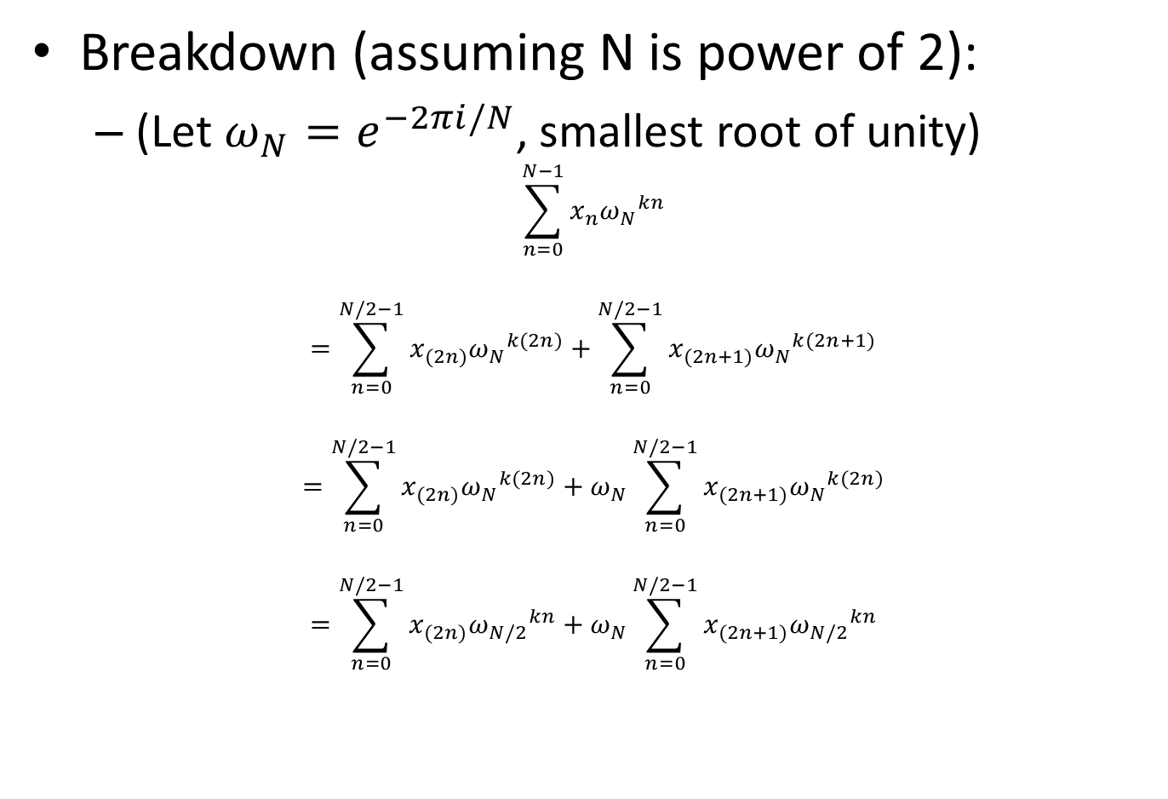
(Proof)
Breakdown (assuming N is power of 2):
(Let $ω_{N}=e^{−2πi/N}$, smallest root of unity)
$$\sum_{n=0}^{N−1}{x_{n}{ω_{N}}^{kn}}$$
$$=\sum_{n=0}^{N/2−1}{x_{(2n)}{ω_{N}}^{k(2n)}}+\sum_{n=0}^{N/2−1}{x_{(2n+1)}{ω_{N}}^{k(2n+1)}}$$
$$=\sum_{n=0}^{N/2−1}{x_{(2n)}{ω_{N}}^{k(2n)}}+ω_{N}\sum_{n=0}^{N/2−1}{x_{(2n+1)}{ω_{N}}^{k(2n)}}$$
$$=\sum_{n=0}^{N/2−1}{x_{(2n)}{ω_{N/2}}^{kn}}+ω_{N}\sum_{n=0}^{N/2−1}{x_{(2n+1)}{ω_{N/2}}^{kn}}$$

Slide 17
(Proof)
Breakdown (assuming N is power of 2):
(Let $ω_{N}=e^{−2πi/N}$, smallest root of unity)
$$\sum_{n=0}^{N−1}{x_{n}{ω_{N}}^{kn}}$$
$$=\sum_{n=0}^{N/2−1}{x_{(2n)}{ω_{N}}^{k(2n)}}+\sum_{n=0}^{N/2−1}{x_{(2n+1)}{ω_{N}}^{k(2n+1)}}$$
$$=\sum_{n=0}^{N/2−1}{x_{(2n)}{ω_{N}}^{k(2n)}}+ω_{N}\sum_{n=0}^{N/2−1}{x_{(2n+1)}{ω_{N}}^{k(2n)}}$$
$$=\sum_{n=0}^{N/2−1}{x_{(2n)}{ω_{N/2}}^{kn}}+ω_{N}\sum_{n=0}^{N/2−1}{x_{(2n+1)}{ω_{N/2}}^{kn}}$$
DFT of x_{n}, even n!
DFT of x_{n}, odd n!

Slide 18
(Divide-and-conquer algorithm)
Recursive-FFT(Vector x):
if x is length 1:
return x
x_even <- (x0, x2, ..., x_(n-2) )
x_odd <- (x1, x3, ..., x_(n-1) )
y_even <- Recursive-FFT(x_even)
y_odd <- Recursive-FFT(x_odd)
for k = 0, …, (n/2)-1:
y[k] <- y_even[k] + w^{k} * y_odd[k]
y[k + n/2] <- y_even[k] - w^{k} * y_odd[k]
return y

Slide 19
(Divide-and-conquer algorithm)
Recursive-FFT(Vector x):
if x is length 1:
return x
x_even <- (x0, x2, ..., x_(n-2) )
x_odd <- (x1, x3, ..., x_(n-1) )
y_even <- Recursive-FFT(x_even)
y_odd <- Recursive-FFT(x_odd)
for k = 0, …, (n/2)-1:
y[k] <- y_even[k] + w^{k} * y_odd[k]
y[k + n/2] <- y_even[k] - w^{k} * y_odd[k]
return y
T(n/2)
T(n/2)
O(n)

Slide 20
Runtime
Recurrence relation:
T(n) = 2T(n/2) + O(n)
O(n log n) runtime! Much better than O(n²)
(Minor caveat: N must be power of 2)
Usually resolvable

Slide 21
Parallelizable?
O(n²) algorithm certainly is!
for k = 0,…,N-1:
for n = 0,…,N-1:
...
Sometimes parallelization outweighs runtime!
(N-body problem, …)

Slide 22
Recursive index tree
x0, x1, x2, x3, x4, x5, x6, x7
x0, x2, x4, x6
x1, x3, x5, x7
x0, x4
x2, x6
x1, x5
x3, x7
x0
x4
x2
x6
x1
x5
x3
x7

Slide 23
Recursive index tree
x0, x1, x2, x3, x4, x5, x6, x7
x0, x2, x4, x6
x1, x3, x5, x7
x0, x4
x2, x6
x1, x5
x3, x7
x0
x4
x2
x6
x1
x5
x3
x7
Order?

Slide 24
Bit-reversal order
0 000
4 100
2 010
6 110
1 001
5 101
3 011
7 111

Slide 25
Bit-reversal order
0 000 reverse of… 000 0
4 100 001 1
2 010 010 2
6 110 011 3
1 001 100 4
5 101 101 5
3 011 110 6
7 111 111 7

Slide 26
(Divide-and-conquer algorithm review)
Recursive-FFT(Vector x):
if x is length 1:
return x
x_even <- (x0, x2, ..., x_(n-2) )
x_odd <- (x1, x3, ..., x_(n-1) )
y_even <- Recursive-FFT(x_even)
y_odd <- Recursive-FFT(x_odd)
for k = 0, …, (n/2)-1:
y[k] <- y_even[k] + w^{k} * y_odd[k]
y[k + n/2] <- y_even[k] - w^{k} * y_odd[k]
return y
T(n/2)
T(n/2)
O(n)

Slide 27
Iterative approach
x0, x1, x2, x3, x4, x5, x6, x7
Stage 3
x0, x2, x4, x6
x1, x3, x5, x7
Stage 2
x0, x4
x2, x6
x1, x5
x3, x7
Stage 1
x0
x4
x2
x6
x1
x5
x3
x7
Bit-reversed accesses (a la sum reduction)

Slide 28
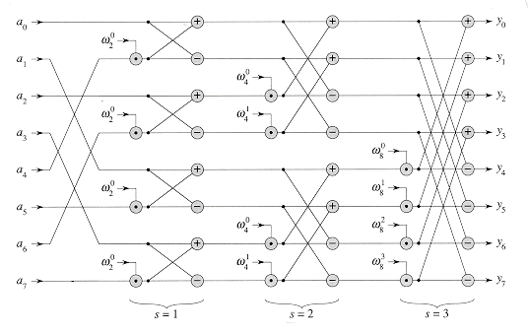
Iterative approach
Bit-reversed access
Stage 1
Stage 2
Stage 3
http://staff.ustc.edu.cn/~csli/graduate/algorithms/book6/chap32.htm

Slide 29
Iterative approach
Bit-reversed access
Stage 1
Stage 2
Stage 3
Iterative-FFT(Vector x):
y <- (bit-reversed order x)
N <- y.length
for s = 1,2,…,lg(N):
m <- 2^{s}
w_{n} <- e^{2πj/m}
for k: 0 ≤ k ≤ N-1, stride m:
for j = 0,…,(m/2)-1:
u <- y[k + j]
t <- (w_{n})^{j} * y[k + j + m/2]
y[k + j] <- u + t
y[k + j + m/2] <- u - t
return y
http://staff.ustc.edu.cn/~csli/graduate/algorithms/book6/chap32.htm

Slide 30
CUDA approach
Bit-reversed access
Stage 1
Stage 2
Stage 3
http://staff.ustc.edu.cn/~csli/graduate/algorithms/book6/chap32.htm

Slide 31
CUDA approach
__syncthreads() barriers!
Bit-reversed access
Stage 1
Stage 2
Stage 3
http://staff.ustc.edu.cn/~csli/graduate/algorithms/book6/chap32.htm

Slide 32
CUDA approach
Non-coalesced memory access!!
__syncthreads() barriers!
Bit-reversed access
Stage 1
Stage 2
Stage 3
http://staff.ustc.edu.cn/~csli/graduate/algorithms/book6/chap32.htm

Slide 33
CUDA approach
Non-coalesced memory access!!
Bank conflicts!!
__syncthreads() barriers!
Bit-reversed access
Stage 1
Stage 2
Stage 3
http://staff.ustc.edu.cn/~csli/graduate/algorithms/book6/chap32.htm

Slide 34
CUDA approach
Non-coalesced memory access!!
Bank conflicts!!
__syncthreads() barriers!
Bit-reversed access
Stage 1
Stage 2
Stage 3
THIS IS WHY WE HAVE LIBRARIES
http://staff.ustc.edu.cn/~csli/graduate/algorithms/book6/chap32.htm

Slide 35

cuFFT
FFT library included with CUDA
Approximately implements previous algorithms
(Cooley-Tukey/Bluestein)
Also handles higher dimensions
Handles nasty hardware constraints that you don’t want to think about
Also handles inverse FFT/DFT similarly
Just a sign change in complex terms

Slide 36
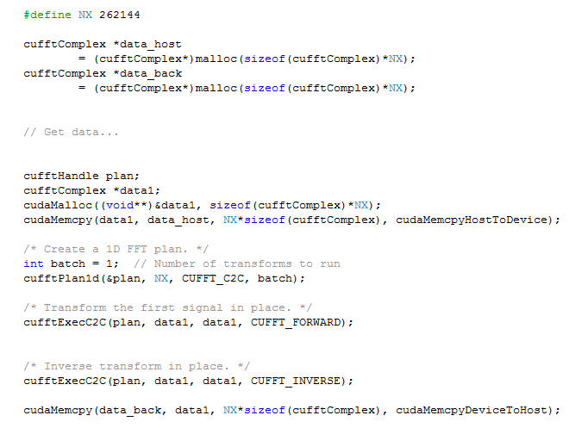
cuFFT 1D example
Correction: Remember to use cufftDestroy(plan) when finished with transforms

Slide 37
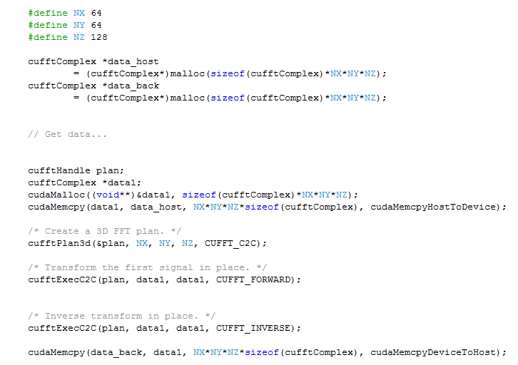
cuFFT 3D example
Correction: Remember to use cufftDestroy(plan) when finished with transforms

Slide 38
Remarks
As before, some parallelizable algorithms don’t easily “fit the mold”
Hardware matters more!
Some resources:
Introduction to Algorithms (Cormen, et al), aka “CLRS”, esp. Sec 30.5
“An Efficient Implementation of Double Precision 1-D FFT for GPUs Using CUDA” (Liu, et al.)

